Slide 1
NAVIO 2 드론 제작
2019년 6월 9일
성병문
한세대학교 자율 비행

Slide 2
NAVIO 개요

Slide 3
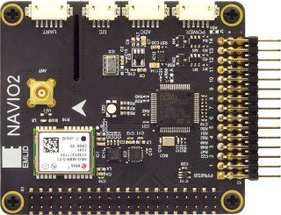
NAVIO2
홈페이지
https://emlid.com/navio/
https://docs.emlid.com/navio2/
What is NAVIO2?
Autopilot HAT(Hardware Attached on Top) for Raspberry Pi
Powered by ArduPilot and ROS
Supports PX4
$ 168
Turn your Raspberry Pi® into a drone controller

Slide 4
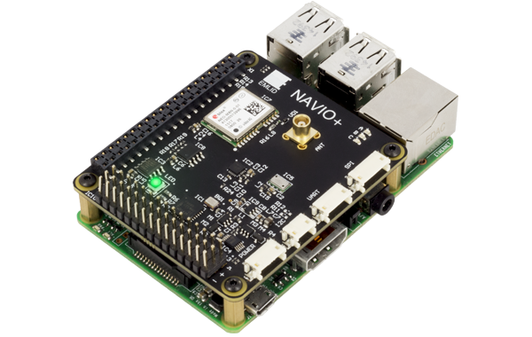
NAVIO2 특징
GNSS receiver
Tracks GPS, GLONASS, Beidou, Galileo and SBAS satellites. External antenna with MCX connector
Dual IMU
Accelerometers, gyroscopes and magnetometers for orientation and motion sensing
RC I/O co-processor
Accepts PPM/SBUS input and provides 14 PWM output channels for motors and servos
High resolution barometer
Senses altitude with 10 cm resolution
Extension ports
Exposed ADC, I2C and UART interfaces for sensors and radios
Triple redundant power supply
With overvoltage protection and power module port for voltage and current sensing

Slide 5

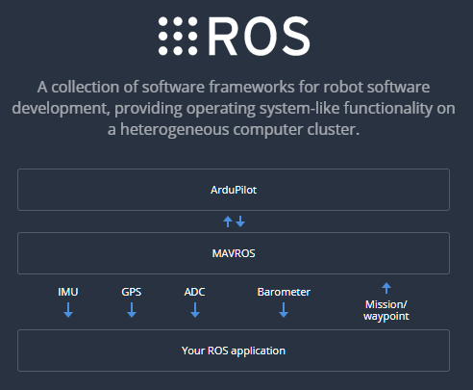
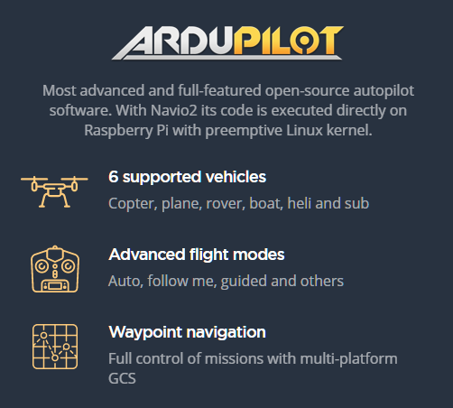
NAVIO OS 설치
This is a Raspbian you know with ArduPilot and ROS preinstalled and ready to run with a couple of simple commands. Also comes with DroneKit and GStreamer

Slide 6
NAVIO H/W 조립
조립

Slide 7
NAVIO2 드론 조립 예
https://community.emlid.com/t/first-build-quadcopter-autonomous-drone-rpi-3-b-navio2/12597

Slide 8
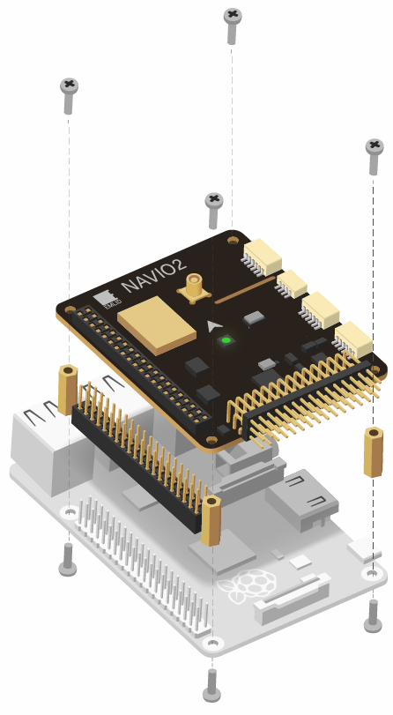
NAVIO2 조립
홈페이지
https://docs.emlid.com/navio2/
Powering Navio2 Attention
ALL POWER SOURCES SHOULD PROVIDE VOLTAGE IN 4.8-5.3V RANGE, OTHERWISE YOU CAN DAMAGE YOUR NAVIO2 AND RASPBERRY PI.**
Navio2 has three power sources, all of them can be used simultaneously as they are protected by ideal diodes.

Slide 9
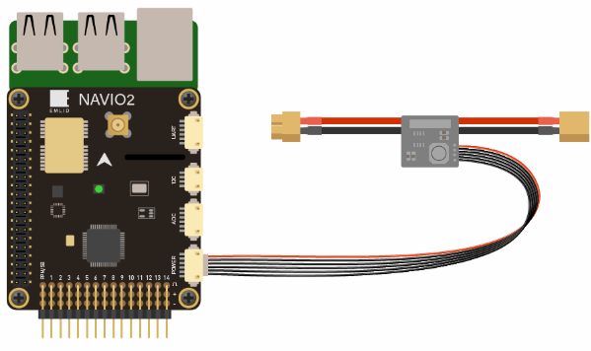
파워 공급
Navio2 should be powered by a power module connected to the “POWER” port on Navio2.
Navio2 will provide power to the Raspberry Pi.

Slide 10
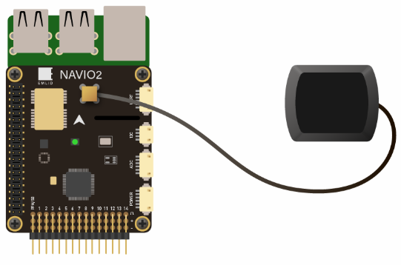
GPS 연결

Slide 11
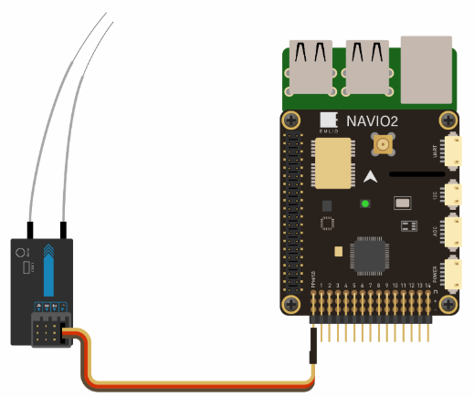
RC input
Navio2 supports PPM and SBUS signals as an RC input.
To connect receivers that do not support PPM output you can use PPM encoder.
PPM receiver is powered by Navio2 and does not require power on the servo rail.

Slide 12
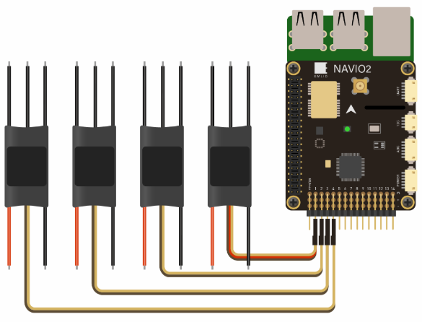
ESC 연결
ESCs are connected to RC outputs labeled from 1 to 14 on a 2.54mm header.
Only one ESC power wire (central) should be connected to Navio2 servo rail, otherwise BECs built in ESCs will heat each other.

Slide 13
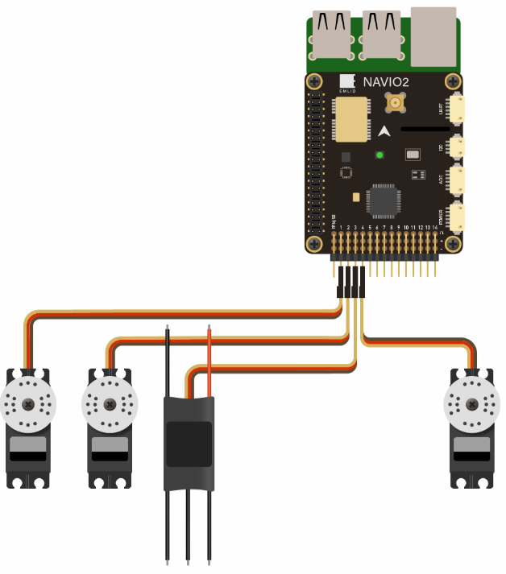
Servo 연결
Servos are connected to RC outputs labeled from 1 to 14 on a 2.54mm header.
Power module does not provide power to servos. To provide power to servos connect BEC to the servo rail. BEC would also serve as back-up power supply to Navio2.

Slide 14
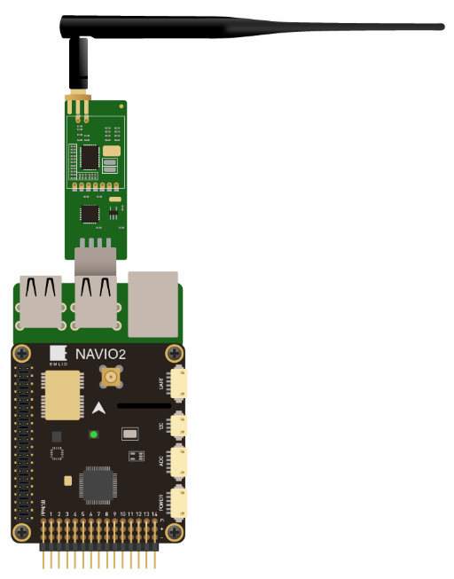
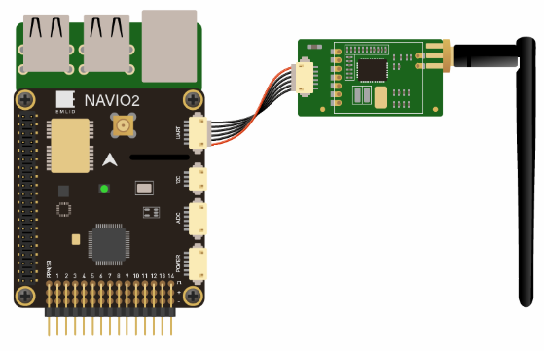
Telemetry Modem
UART radio
For UART port use /dev/ttyAMA0 serial.
USB radio
Use /dev/ttyUSB0 virtual serial port for USB.

Slide 15
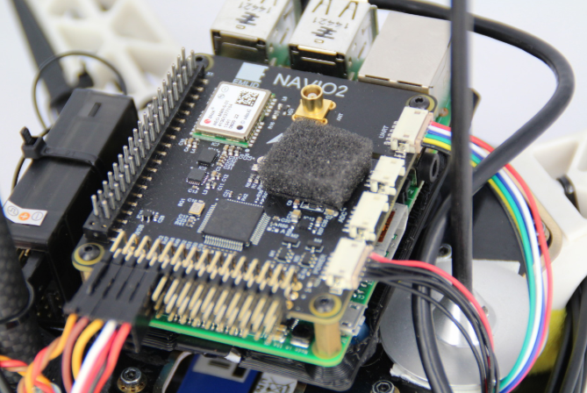
Barometer UV protection
MS5611 barometer (steel cap IC) is sensitive to UV light and might report sudden jumps in altitude under sunlight.
It is very important to cover it with a piece of open cell foam (something like microphone fabric) or put autopilot in a protective case to protect it both from sunlight and airstreams.

Slide 16
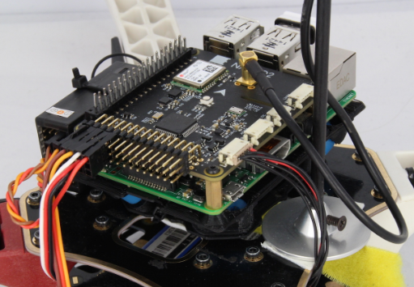
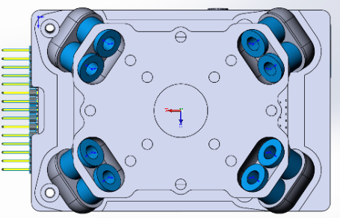
Anti-vibration mount 1
We have designed an anti-vibration for Navio that can be easily 3D printed.
It significantly simplifies mounting and eliminates vibrations.

Slide 17
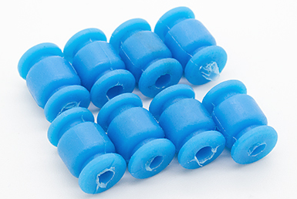
Anti-vibration mount 2
STL Files
Top
https://github.com/emlid/hardware/blob/master/VibroNavio2top_rev_A.STL
Bottom
https://github.com/emlid/hardware/blob/master/VibroNavio2bot_rev_A.STL
You will also need 8 blue vibration damping balls from Hobbyking

Slide 18
NAVIO S/W 설치
조립

Slide 19
라즈비안 설치
기설정된 라즈비안 이미지 다운로드
http://files.emlid.com/images/emlid-raspbian-20190227.img.xz

Slide 20
Wi-Fi 설정
sudo vi /etc/wpa_supplicant/wpa_supplicant.conf
network={
ssid="yourssid"
psk="yourpasskey"
}
Expading rootfs
sudo raspi-config --expand-rootfs

Slide 21
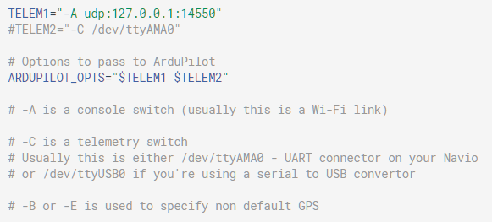
Specifying launching options
Open the file:
pi@navio: ~ $ sudo nano /etc/default/arducopter
Here you can specify IP of your ground station.

Slide 22
GT-R530 NX

Slide 23
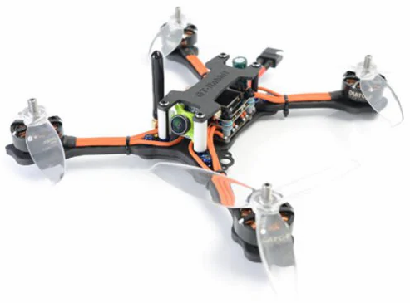
GT-R530 NX
가격 : $ 200
F405 Flight Controller
Item Name: F405 Betaflight FC AIO OSD BEC
Input Power: 12.6 - 25V ( 3 - 6S )
BEC: 5V / 1.5A
MCU: STM32F405
Gyro: MPU6000, 8K Six-Axis
Max Lipo Cell: 3 – 5
FPV Transmitter
FPV Camera
Item Name: Runcam Micro Swift FPV
Camera
Image Sensor: 1/3 inch SONY Super HAD II Signal System: PAL / NTSC
S / N Ratio: more than 60dB ( AGC OFF )
Electronic Shutter Speed: PAL: 1 / 50 ~ 100,000; NTSC: 1 / 60 ~ 100,000
AutoGain Control ( AGC ): YES
Power: DC 5 to 36V

Slide 24
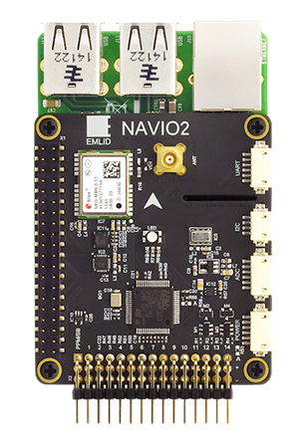
NAVIO2 + GT-R530 드론 조립
구분 | 제품 | 모델/스펙 | 가격 | 수량
 | 모터/센서/본체 | GT - R530 NX | 23만원 | 1
 | 컴퓨터 | RASPBERRY PI B+ | 5 만원 | 1
 | 콘트롤러 | NAVIO2 | 20 만원 | 1
계 |  |  | 48 만원

Slide 25
NAVIO2 기반 드론 조립
콘트롤러
NAVIO2 (10만원)
https://emlid.com/navio/
본체
GT-R530 NX( $ 243 )
https://www.gearbest.com/brush-fpv-racer/pp_009542172048.html?wid=1433363
SHRC H1G ($ 94)
https://www.gearbest.com/rc-quadcopters/pp_009187953341.html?wid=1433363
JDRC JD ($ 80)
https://www.gearbest.com/rc-quadcopters/pp_009531904281.html?wid=1433363
GEPRC Mark2 ($ 264)
https://www.gearbest.com/brush-fpv-racer/pp_009166157856.html?wid=1433363
Aurora RC Mini Fight ($ 137)
https://www.gearbest.com/brushless-fpv-racer/pp_1156927.html?wid=1433363

Slide 26
NAVIO2 드론 조립 예
https://community.emlid.com/t/first-build-quadcopter-autonomous-drone-rpi-3-b-navio2/12597

Slide 27
끝.

